Slide 1

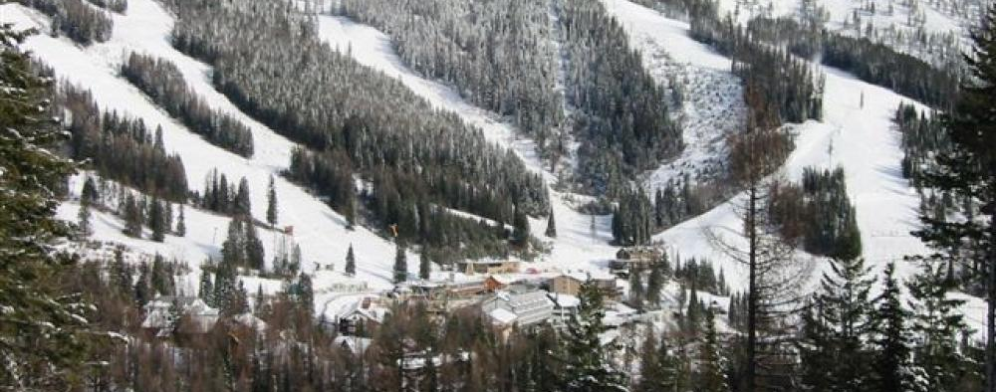
Big Mountain Resort
Guided Capstone Project Report

Slide 2


Problem Identification
Additional operating costs this season of $1.5M
Need to maximize returns on facilities currently being offered
Notes:
Problem identification (1-2 slides)
Recommendation and key findings (1 slide)
Modeling results and analysis (3-4 slides)
Summary and conclusion (1 slide)

Slide 3


Recommendations
Expand facilities through
Additional run
Vertical drop increase of 150 feet
Installing additional chair lift
Possibly, 2 acres addition of snow maker area coverage*
* Subject to business expenses

Slide 4

Modeling & Analysis
Exploratory Data Analysis
Summary data/statistics
Scaling
Principal component analysis (PCA) of high dimensional data
Correlation
Notes:
Took summary data and developed relevant features (resorts per 100K square miles, resort density, etc.)
Scale numerical data (heterogenous)
PCA to derive features to get average price per state
Correlation map

Slide 5



Modeling & Analysis (contd.)
Model Selection
Linear regression vs. random forest regression
Modeling in train set and assessing on test set
Refining models through pipeline
Compare performance via error metric
Notes:
Took summary data and developed relevant features (resorts per 100K square miles, resort density, etc.)
Scale numerical data (heterogenous)
PCA to derive features to get average price per state
Correlation map

Slide 6
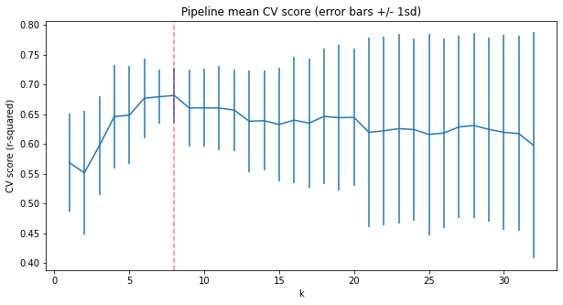
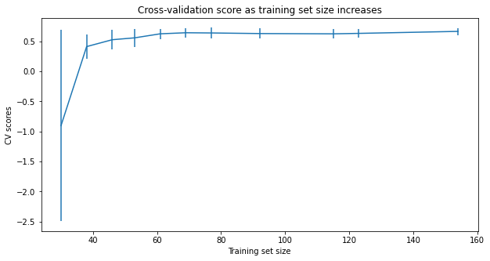
Modeling Results
Linear Regression
Random Forest Regression
MAE = $9.5
MAE = $11.8
Notes:
RF = mae is lower, less variability, verifying performance on the test set produces performance constistent with the corss validation results

Slide 7

Summary and conclusion
There are limitations
Given what we have in data provided
Expand on valuable amenities
Incorporate data team to gather additional sample and data
Build on the model to predict future development investments

